Slide 1

Sales Prediction Dataset Analysis
By:- Siddhikesh Gavit

Slide 2
Dataset Explanation:-
TV: Advertising expenditure on television to reach a broad audience.
Radio: Advertising expenditure on radio to target specific demographics.
Newspaper: Advertising expenditure on newspapers to target local audiences.
Sales: The number of units sold corresponding to advertising expenditures.

Slide 3
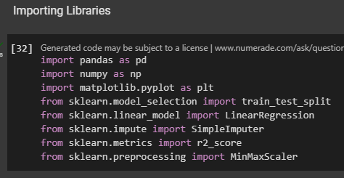
Libraries Used:-
Pandas
Numpy
Matplotlib
Sklearn with other modules and methods

Slide 4
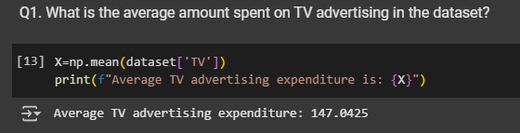
Q1.What is the average amount spent on TV advertising in the dataset?
Result: The average expenditure on TV advertising is 147.0425.
Insight: This value helps us understand how much the company is
investing in TV ads compared to other platforms.

Slide 5
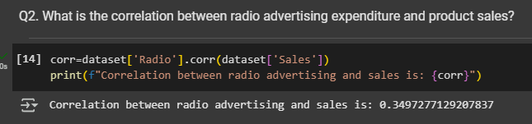
Q2. What is the correlation between radio advertising expenditure and product sales?
Result: The correlation is 0.35 approx.
Insight: A positive correlation suggests that higher spending on radio ads tends to
increase sales, while a negative correlation would indicate the opposite.

Slide 6
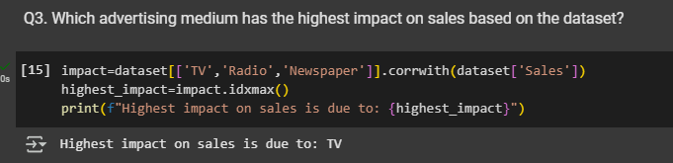
Q3. Which advertising medium has the highest impact on sales based on the dataset?
Result: The TV advertising expenditure has the highest impact on sales.
Insight: This indicates that TV advertising is the most effective medium in driving
product sales among the three.

Slide 7
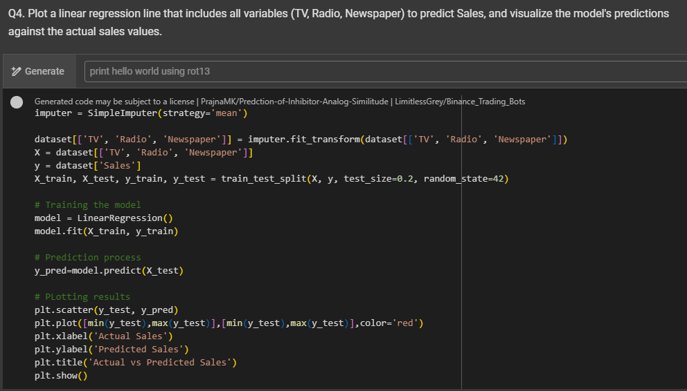
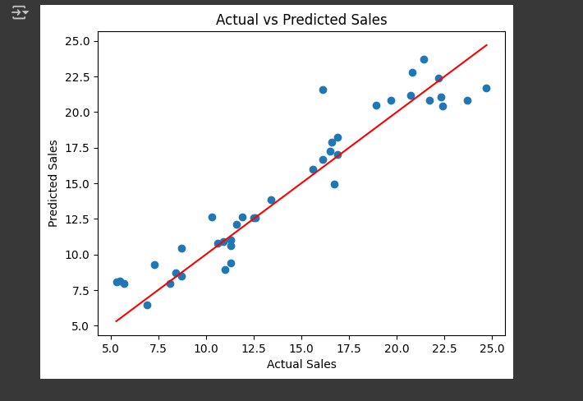
Q4. Plot a linear regression line to predict Sales based on all variables (TV, Radio, Newspaper).
Result: A regression line showing the relationship between TV, Radio, Newspaper
expenditures and Sales.
Insight: This model helps predict sales based on the given advertising expenditures.
We can observe how each medium contributes to the overall sales prediction.

Slide 8
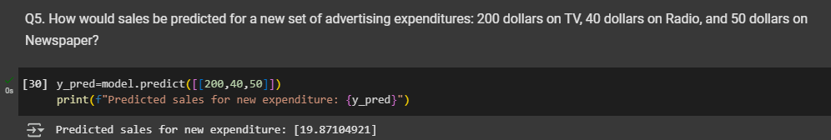
Q5. How would sales be predicted for $200 on TV, $40 on Radio, and $50 on Newspaper?
Result: The predicted sales are 19.87 approx.
Insight: This prediction can help in planning future advertising budgets to achieve
desired sales targets.

Slide 9
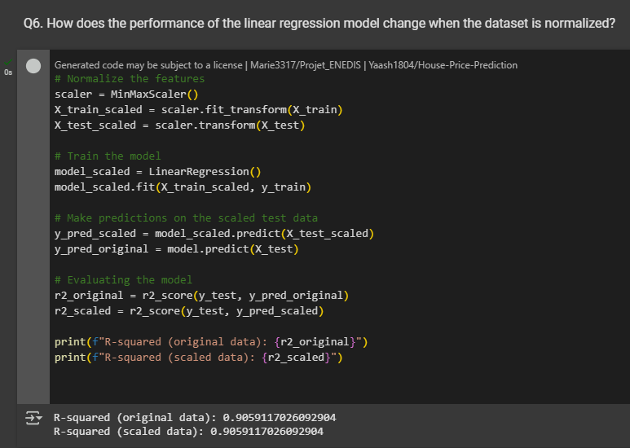
Q6. How does the performance of the linear regression model change when the dataset is normalized?
Result: Normalizing the data results in R-sq_original=0.90 & R-sq_scaled=0.90
Insight: Normalization can improve the performance of the regression model by ensuring all
variables have equal weight in the model.

Slide 10
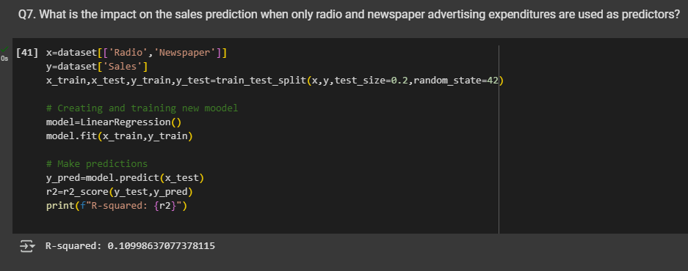
Q7. What is the impact on sales prediction when only radio and newspaper expenditures are used as predictors?
Result: The model performance is 0.109 approx.
Insight: Removing TV expenditure decreases the predictive accuracy, highlighting the
importance of TV advertising in the model.

Slide 11
THANK YOU…
@Finlatics…

